Slide 1
Logistic regression

Slide 2
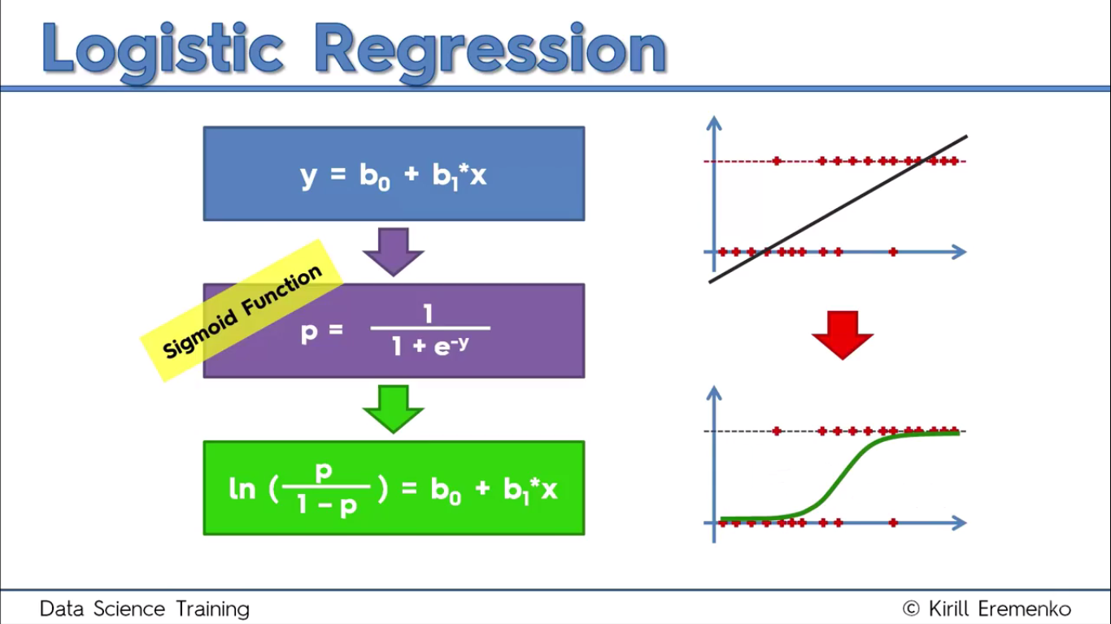

Slide 3
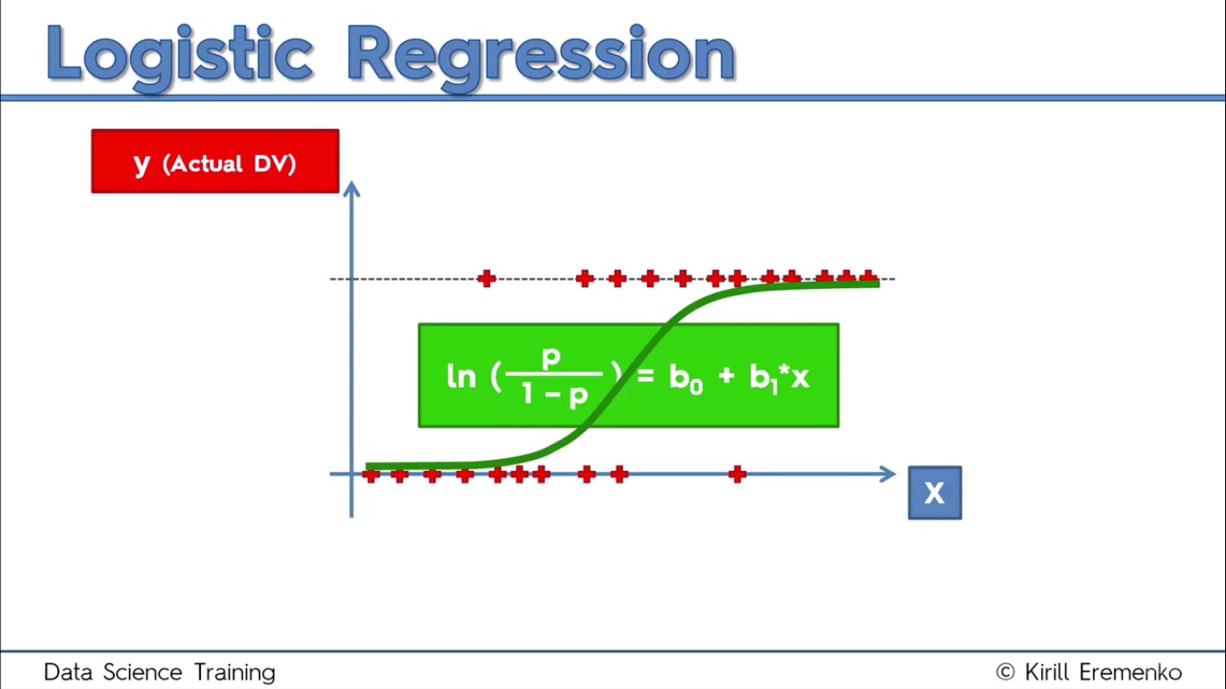

Slide 4
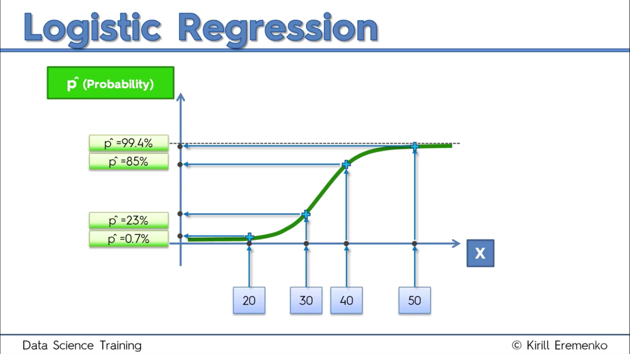

Slide 5
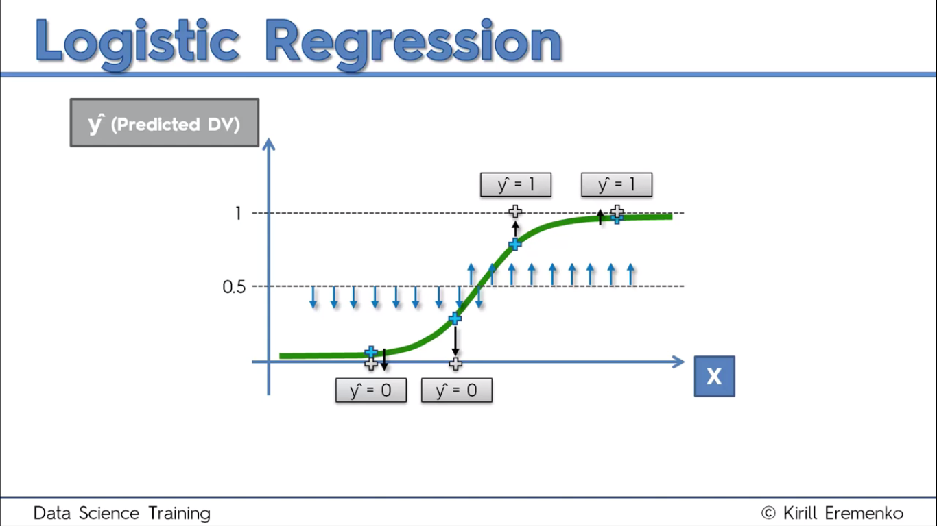

Slide 6

Python

Slide 7
Reading dataset dynamically
from tkinter import *
from tkinter.filedialog import askopenfilename
root = Tk()
root.withdraw()
root.update()
file_path = askopenfilename()
root.destroy()

Slide 8
Importing Libraries
import pandas as pd
import numpy as np
import matplotlib.pyplot as plt

Slide 9
Importing dataset
dataset = pd.read_csv('Social_Network_Ads.csv')
X = dataset.iloc[:,2:4]
y= dataset.iloc[:,-1]

Slide 10
Splitting the dataset into the Training set and Test set
from sklearn.cross_validation import train_test_split
X_train, X_test, y_train, y_test = train_test_split(X, y, test_size = 0.25, random_state = 0)

Slide 11
Feature Scaling
from sklearn.preprocessing import StandardScaler
sc = StandardScaler()
X_train = sc.fit_transform(X_train)
X_test = sc.transform(X_test)

Slide 12
Feature Selection …
Recursive Feature Elimination (RFE) is based on the idea to repeatedly construct a model and choose either the best or worst performing feature, setting the feature aside and then repeating the process with the rest of the features.
This process is applied until all features in the dataset are exhausted. The goal of RFE is to select features.

Slide 13
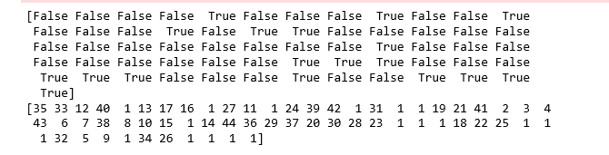
Feature Selection …
from sklearn import datasets
from sklearn.feature_selection import RFE
from sklearn.linear_model import LogisticRegression
logreg = LogisticRegression()
rfe = RFE(logreg, 2)
rfe = rfe.fit(X, y )
print(rfe.support_)

Slide 14
Implementing the model
X = sc.fit_transform(X)
import statsmodels.api as sm
logit_model=sm.Logit(y,X)
result=logit_model.fit()
print(result.summary())
NOTE : The p-values for most of the variables are smaller than 0.05, therefore, most of them are significant to the model.

Slide 15
Logistic Regression model
from sklearn.linear_model import LogisticRegression
classifier = LogisticRegression()
model = classifier.fit(X_train,y_train)
y_pred = classifier.predict(X_test)
model.score(X_test,y_test)

Slide 16
Confusion Matrix
from sklearn.metrics import confusion_matrix
cm = confusion_matrix(y_test, y_pred)

Slide 17
K fold
from sklearn import model_selection
from sklearn.model_selection import cross_val_score
kfold = model_selection.KFold(n_splits=10, random_state=7)
modelCV = LogisticRegression()
scoring = 'accuracy'
results = model_selection.cross_val_score(modelCV, X_train, y_train, cv=kfold, scoring=scoring)
print("10-fold cross validation average accuracy: %.3f" % (results.mean()))

Slide 18
Evaluating classification report
from sklearn.metrics import classification_report
print(classification_report(y_test, y_pred))

Slide 19

R

Slide 20
Read dataset
library(readr)
dataset <- read_csv("D:/machine learning AZ/Machine Learning A-Z Template Folder/Part 3 - Classification/Section 14 - Logistic Regression/Logistic_Regression/Social_Network_Ads.csv")
dataset = dataset[3:5]

Slide 21
Encoding the target feature as factor
dataset$Purchased = factor(dataset$Purchased, levels = c(0, 1))

Slide 22
Splitting the dataset into the Training set and Test set
# install.packages('caTools')
library(caTools)
set.seed(123)
split = sample.split(dataset$Purchased, SplitRatio = 0.75)
training_set = subset(dataset, split == TRUE)
test_set = subset(dataset, split == FALSE)

Slide 23
Feature scaling
training_set[-3] = scale(training_set[-3])
test_set[-3] = scale(test_set[-3])

Slide 24
Fitting Logistic Regression to the Training set
classifier = glm(formula = Purchased ~ .,
family = binomial,
data = training_set)

Slide 25
prediction
prob_pred = predict(classifier, type = 'response', newdata = test_set[-3])
y_pred = ifelse(prob_pred > 0.5, 1, 0)

Slide 26
Confusion matrix
# Making the Confusion Matrix
cm = table(unlist(test_set[, 3]), y_pred )

Slide 27
PLOT
library(ElemStatLearn)
set = training_set
X1 = seq(min(set[, 1]) - 1, max(set[, 1]) + 1, by = 0.01)
X2 = seq(min(set[, 2]) - 1, max(set[, 2]) + 1, by = 0.01)
grid_set = expand.grid(X1, X2)
colnames(grid_set) = c('Age', 'EstimatedSalary')
prob_set = predict(classifier, type = 'response', newdata = grid_set)
y_grid = ifelse(prob_set > 0.5, 1, 0)
plot(set[, -3],
main = 'Logistic Regression (Training set)',
xlab = 'Age', ylab = 'Estimated Salary',
xlim = range(X1), ylim = range(X2))
contour(X1, X2, matrix(as.numeric(y_grid), length(X1), length(X2)), add = TRUE)
points(grid_set, pch = '.', col = ifelse(y_grid == 1, 'springgreen3', 'tomato'))
points(set, pch = 21, bg = ifelse(set[, 3] == 1, 'green4', 'red3'))

